Slide 1


Terrorism & Demographics
https://docs.google.com/presentation/d/1Dv4_oMvHP1tcqSeELV1P3IkvWU_IuylzWD8664CBSYo/edit?usp=sharing

Slide 2
Introduction:
Objectives:
Goal: Understand patterns in terrorism and ascertain whether
there is correlation between demographics and terroristic activity
Ascertain which organizations caused the most deaths and injuries within the past 100 years
Understand which areas of the world suffered the most terrorist attacks in the last 100 years
Examine the common means of attack and their effects
Examine various time periods to determine which decade faced the most terrorist attacks
Survey economic information to determine if there is a correlation between attacks and economic metrics
Examine demographic information to determine if there is a correlation between these metrics and terrorism

Slide 3
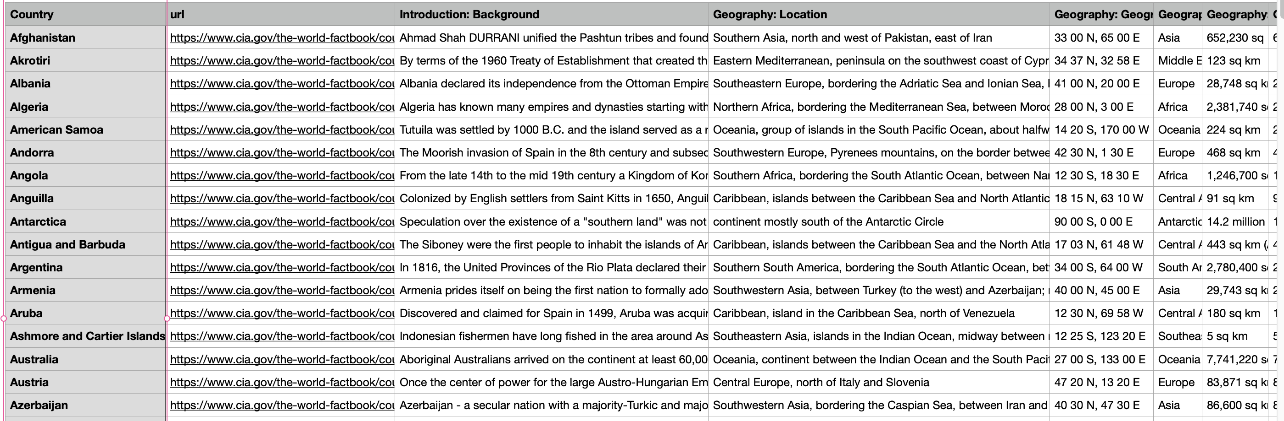
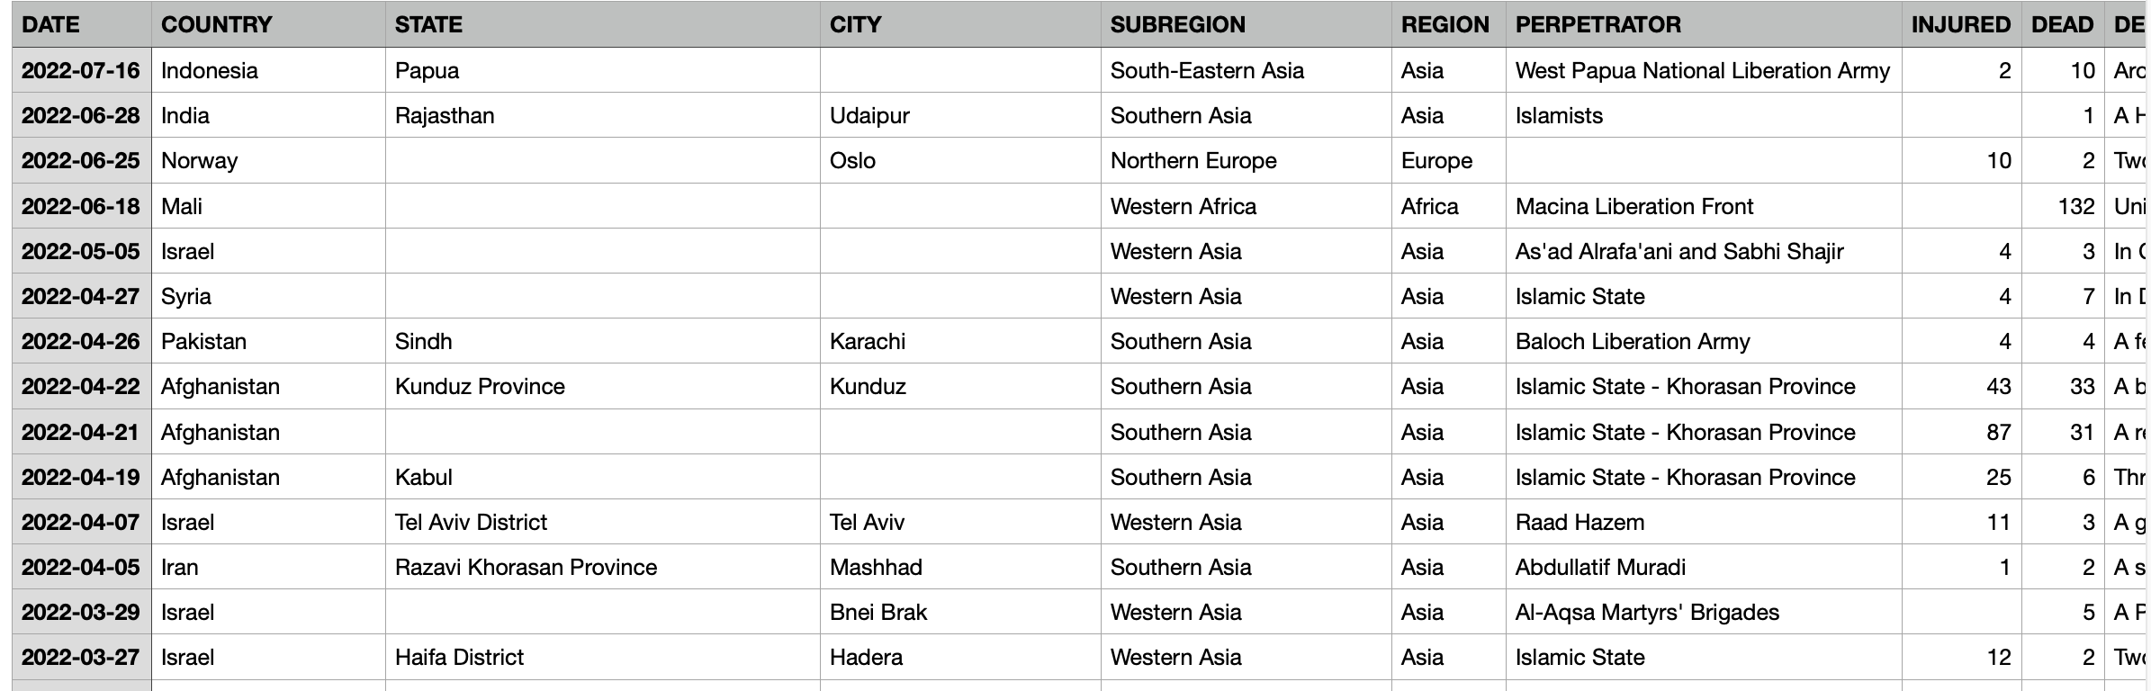

Introduction:
Data Source:
Kaggle
The World FactBook by the CIA
over 1100 columns
258 rows
entry for every country
Global Terrorism Catalogue
data covers mid-1900s to 2022
about 11 columns
around 27,000 rows
Cia FactBook Example
Global Terrorism Catalogue Example

Slide 4





Database management & Web scraping
Tools Used:
Mongo DB
distributed team
Python-friendly
non-relational data
Python
Jupyter Notebook
Excel
NYT API

Slide 5
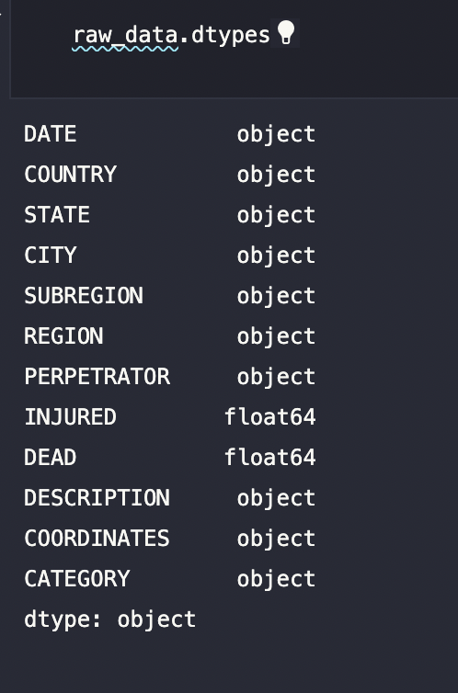
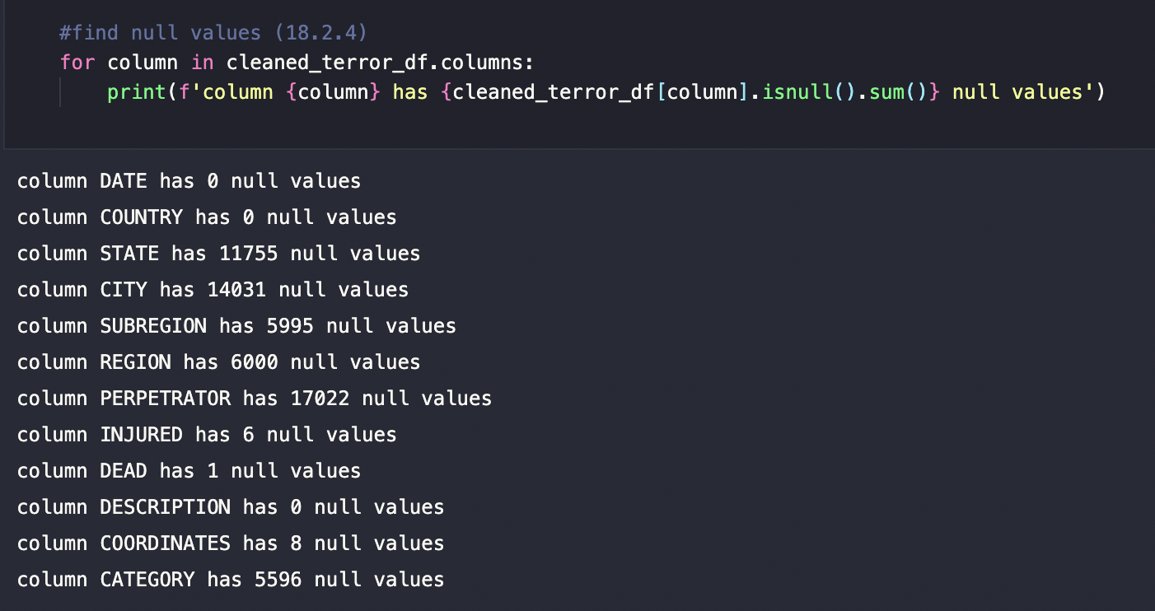
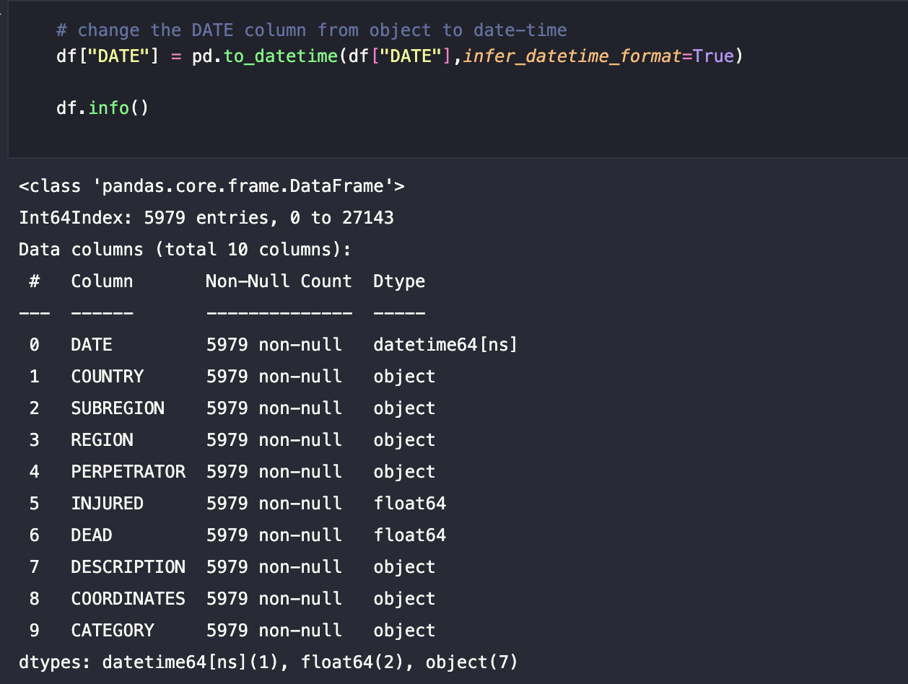
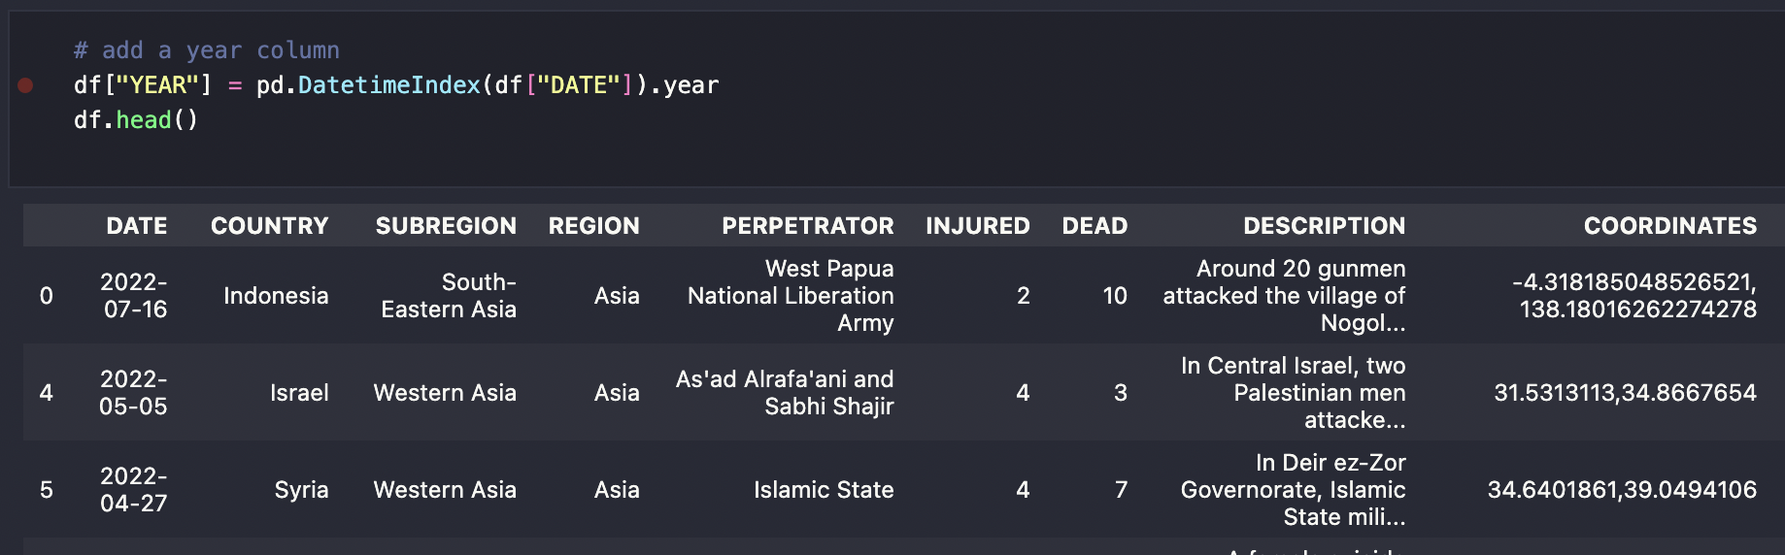
Database management: Cleaning
Global Terrorism Catalog:
dropped nulls
transformed date from object to a date and extract year
transformed coordinates from object to string to create latitude and longitude columns

Slide 6
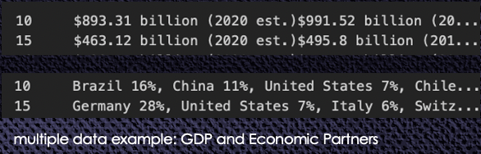
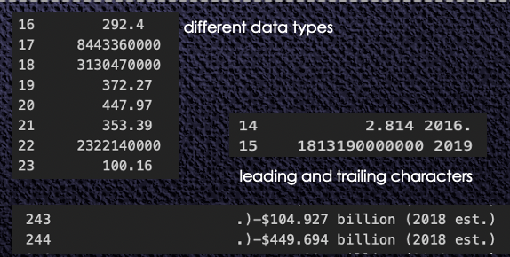
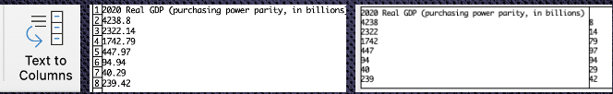

Database management: Cleaning
World Factbook by the CIA:
Examined original data to pull columns related to our goals
loaded final version shape: 258, 48
Cells contained data which needed to be separated
slicing resulted in leading and trailing characters in some instances
Excel: text to columns
Example of using text to columns to split on the “period”

Slide 7
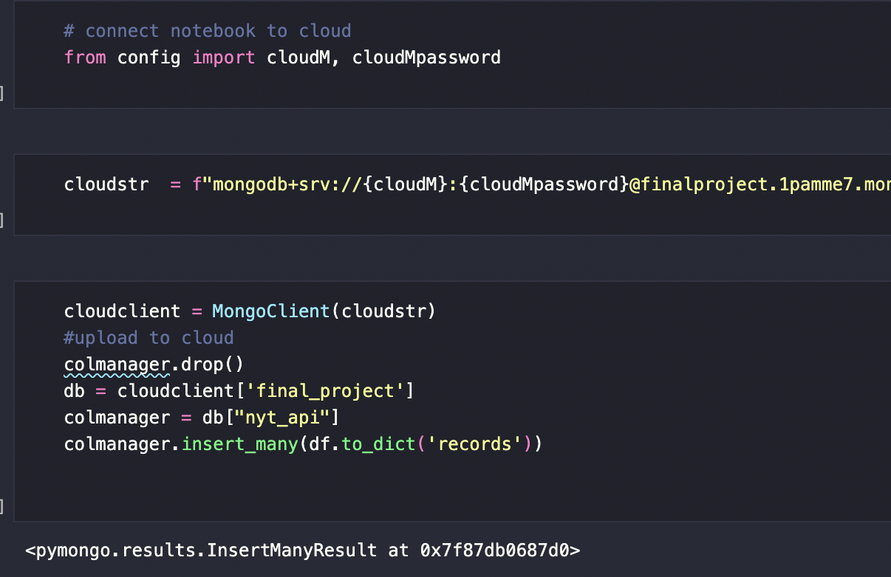
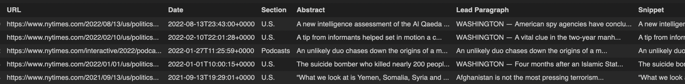
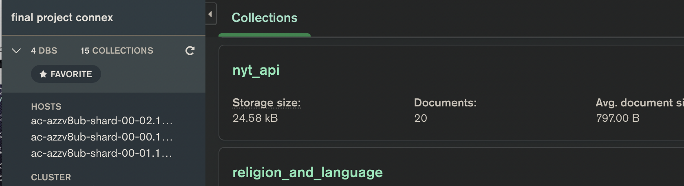
Database management: NYT API
API to avoid violating user terms that may exist
Returned: URL, date, section, abstract, lead paragraph, and snippet
Code snippet connecting to Mongo
API feeds into a Mongo collection, the Dashboard pulls results from Mongo
Mongo Collection Example

Slide 8
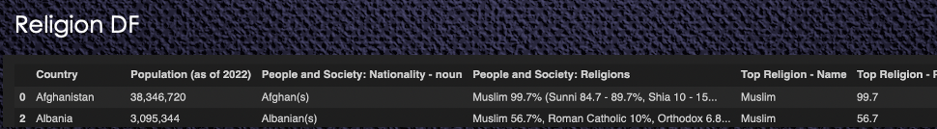
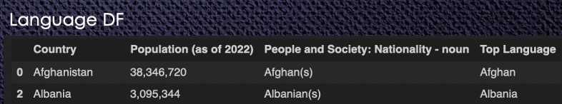
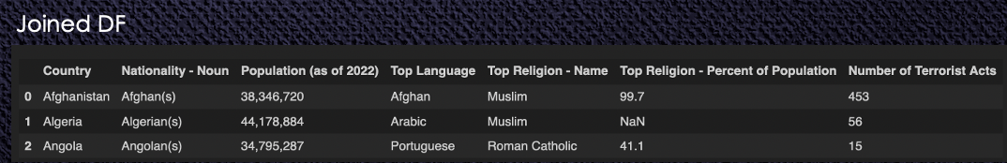
Database management: Join Data Bases
Join Collections:
Cut 2 smaller collections from the CIA collection focusing on religion and language metrics
Joined new data frames with a subset of the terror collection
Final collection is comprised of 3 data frames

Slide 9



Machine Learning: Choosing a Model
Unsupervised model
Agglomerative hierarchical clustering groups clusters of terrorist attacks
The success of the model relies heavily on feature selection
Variables such as gender, GDP, and military expenditures were not included in the model due null values
This model looks at the relationship between variables, it does not make predictions regarding future terrorist attacks

Slide 10
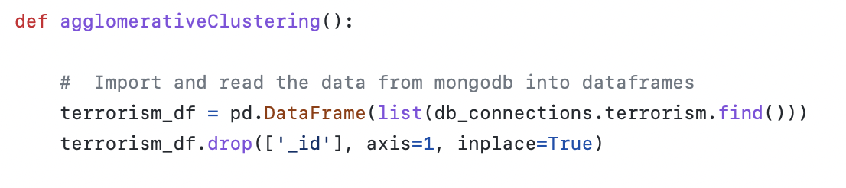
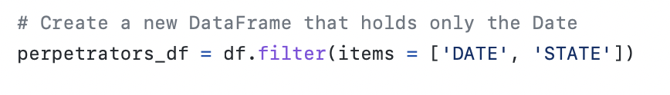
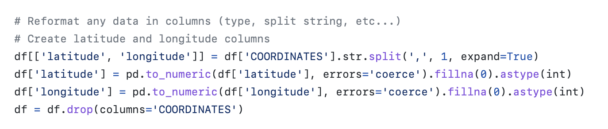
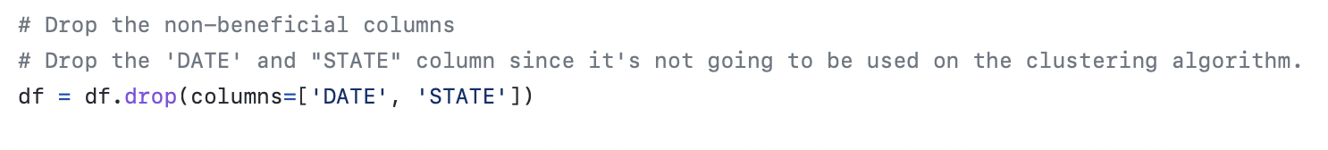
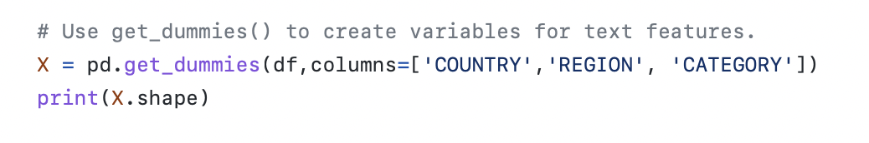
Machine Learning: DATA PROCESSING
Drop non-beneficial columns
Parse latitude and longitude from the
“coordinates’ columns
Create “dummies” for features
Check values and create bins
Features are split into 2 data frames:
categorical information data frame
data frame containing integers for PCA analysis
Agglomerative hierarchical clustering model does not require for the data to be split into testing and training sets

Slide 11
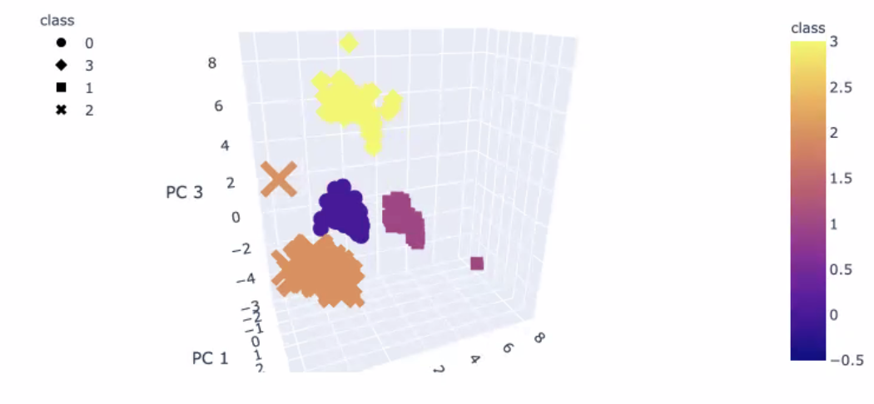
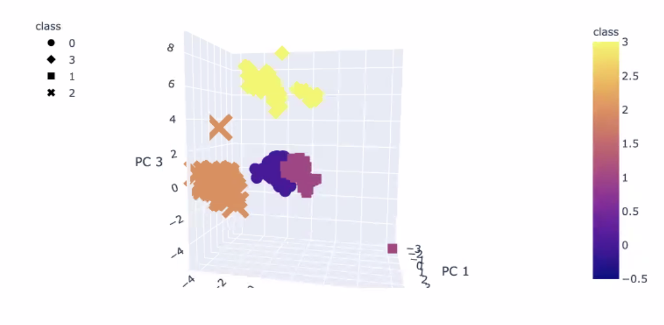
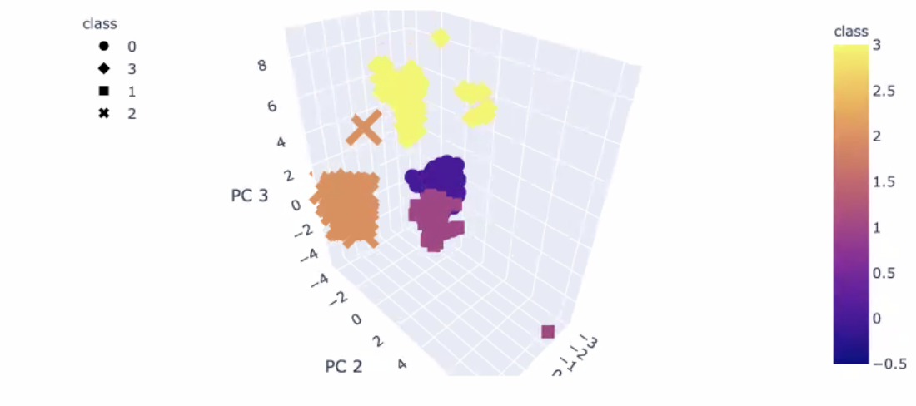
Machine Learning: Results
PCA Variance Ratio Array:
([0.02212923, 0.01560112, 0.01320126])
The variance ratio indicates a weak relationship between:
attack category
region, country
number of injured
number of deceased
similarity between terrorist attacks

Slide 12
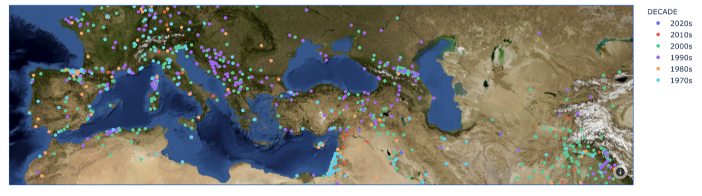



Data Visualizations Mapping with leaflet & mapbox:
An interactive map from data to show
terrorist events and demographic data
Challenge: create a geoJSON from our data

Slide 13


Data Visualizations Heroku Deployment :
Benefits of Heroku:
Fast app deployment
Data integration with 3rd party services such as Mongo
Free services (for now)
[link]

Slide 14
Thank You

